Slide 1
Environmental Data for All

Slide 2
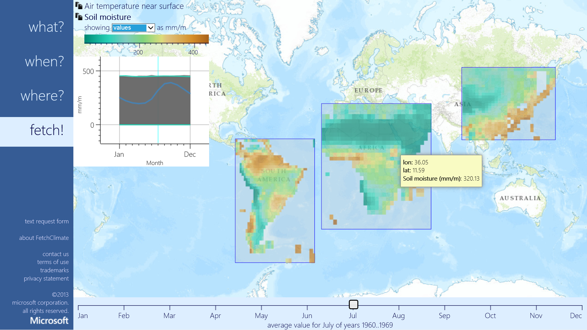

FetchClimate^{Beta}
Intelligent environmental information service
Automatically:
Selects best data source to answer the query
Regrids results
Calculates uncertainty
Notes:
FetchClimate is an ‘automatic intelligent environmental information service’ – in the sense that you ask it for what you want (e.g. temperature at midday in June) and it selects the best data to answer this query; does all necessary calculations on the fly; then sends back the answer, complete with uncertainty. It can be accessed via code (and so used within other tools, such as HYKL), or directly via a compelling browser interface.
See http://research.microsoft.com/en-us/um/cambridge/groups/science/tools/fetchclimate/default.htm

Slide 3
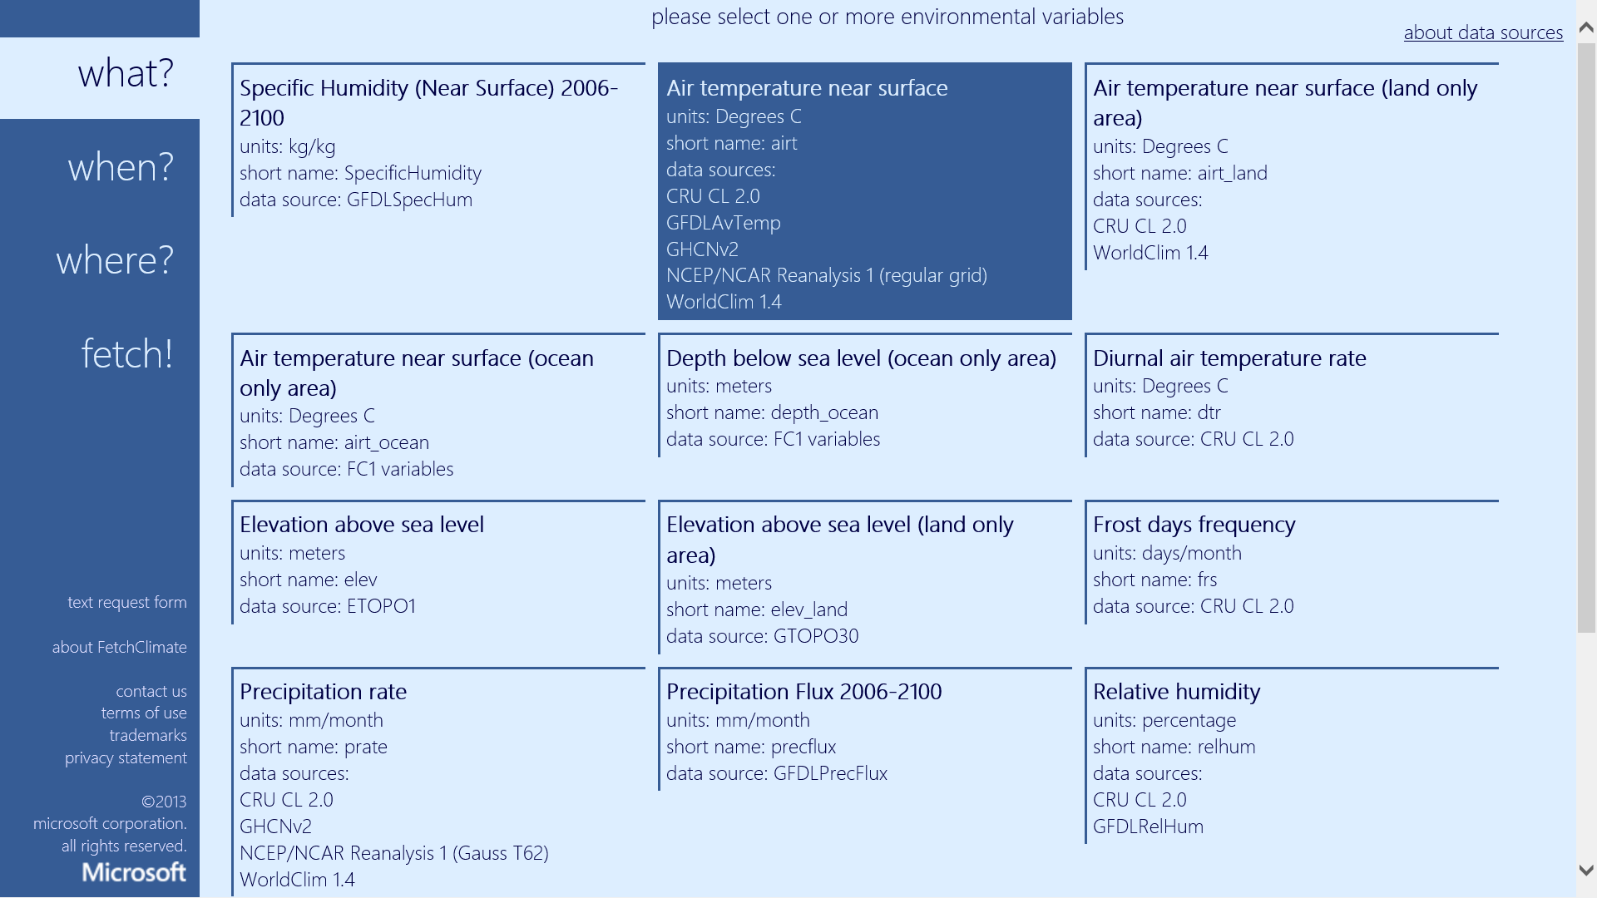
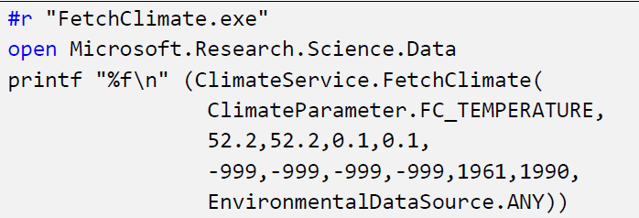
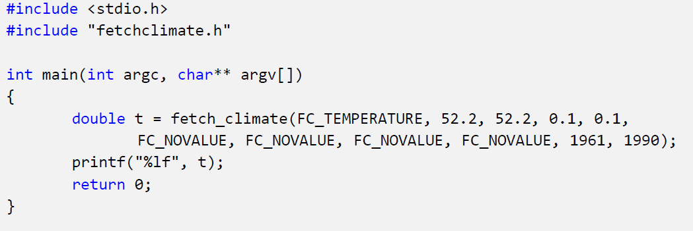
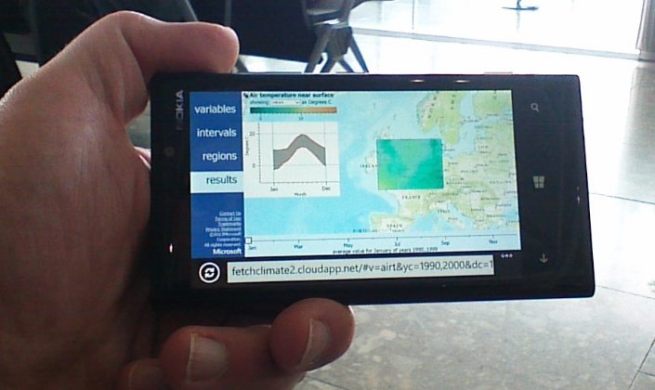
FetchClimate^{Beta}
Web browser app using HTML5
Programmatic API access
Notes:
Web browser shows available fetch variables
HTML5 client works on smartphones & tablets
F# program that prints interpolated mean annual temperature at latitude=52.2°, longitude=0.1° (Cambridge, UK) for 30 years since 1961 may look like this.
C++ program to do the same thing

Slide 4
Notes:
http://fetchclimate2.cloudapp.net/
Note: This is Beta – some fetches may take several minutes, depending on complexity of underlying computation. Performance is being optimised.
Sequence for creating a fetch are:
- What? Select variable/s
- When? Select date/s of data you require and time averaging
- Where? Specify point/region where you want data for
- Fetch! Get results. Note fetch can take between 10s – several minutes, depending on complexity of the fetch. Worth testing beforehand – note results are cached
THIS SCREEN:
1. Select which variable/s you would like to fetch

Slide 5
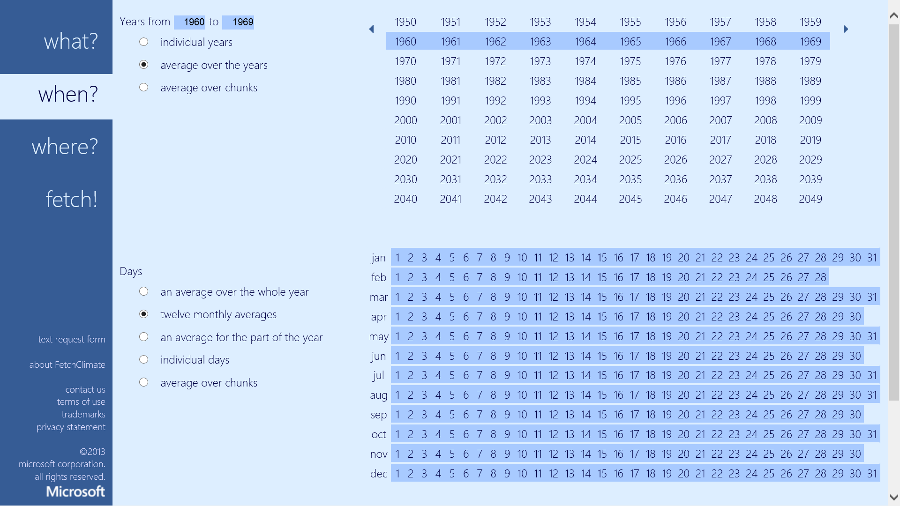
Notes:
2. Select which time interval and averaging you would like to fetch.
It automatically selects the appropriate dataset, based on the query (e.g. historical versus climate prediction for future data)
This screen is a bit detailed/complex as it allows users to specify exact time slices and average. Incredibly flexible.
Annual
Monthly
Daily
UI is being refined

Slide 6
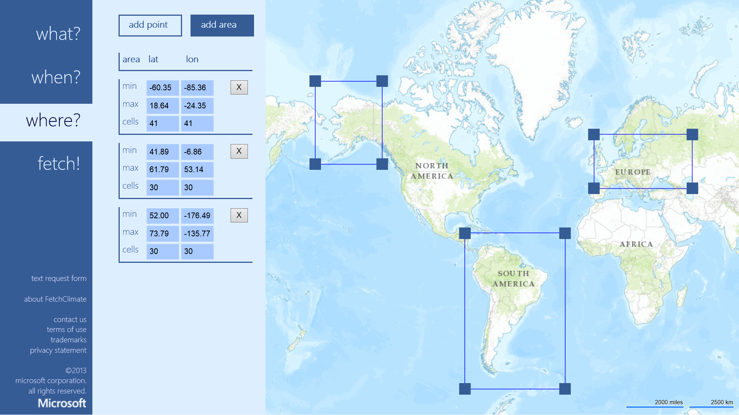
Notes:
Select a region or point at which data is required
Click Add Point or Add Area
For Add Area
- Click mouse/touch to create selection box
- Then drag corners to define bounding box

Slide 7
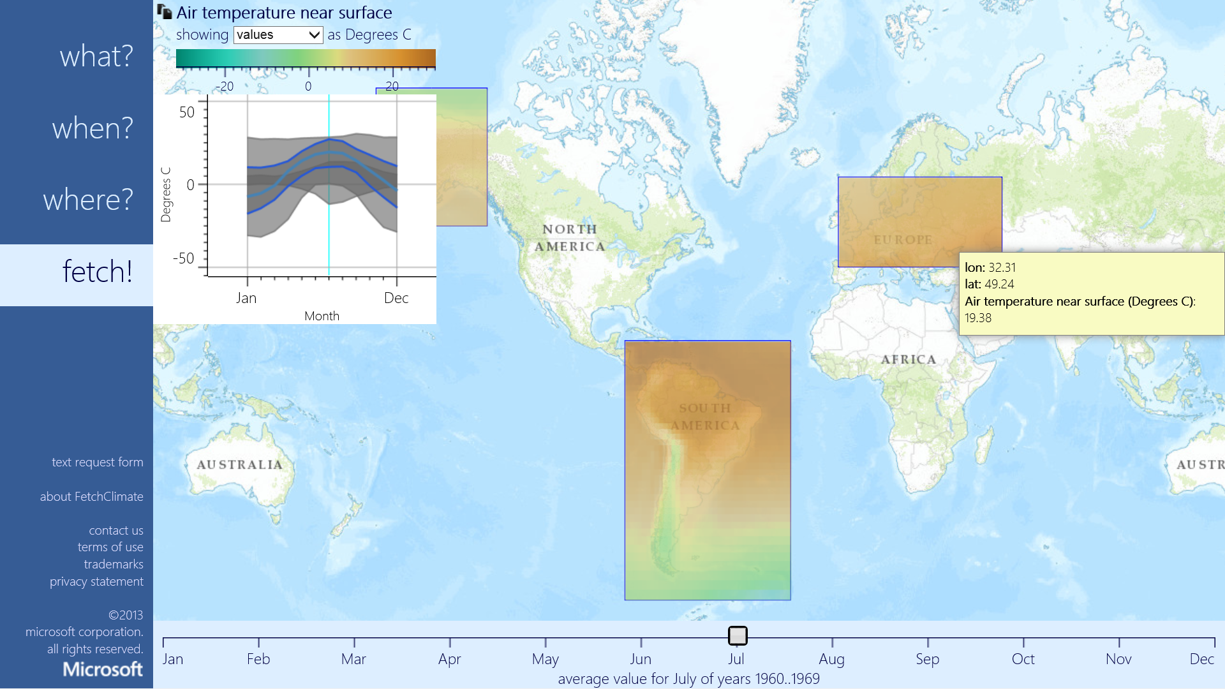
Notes:
Results fetched.

Slide 8
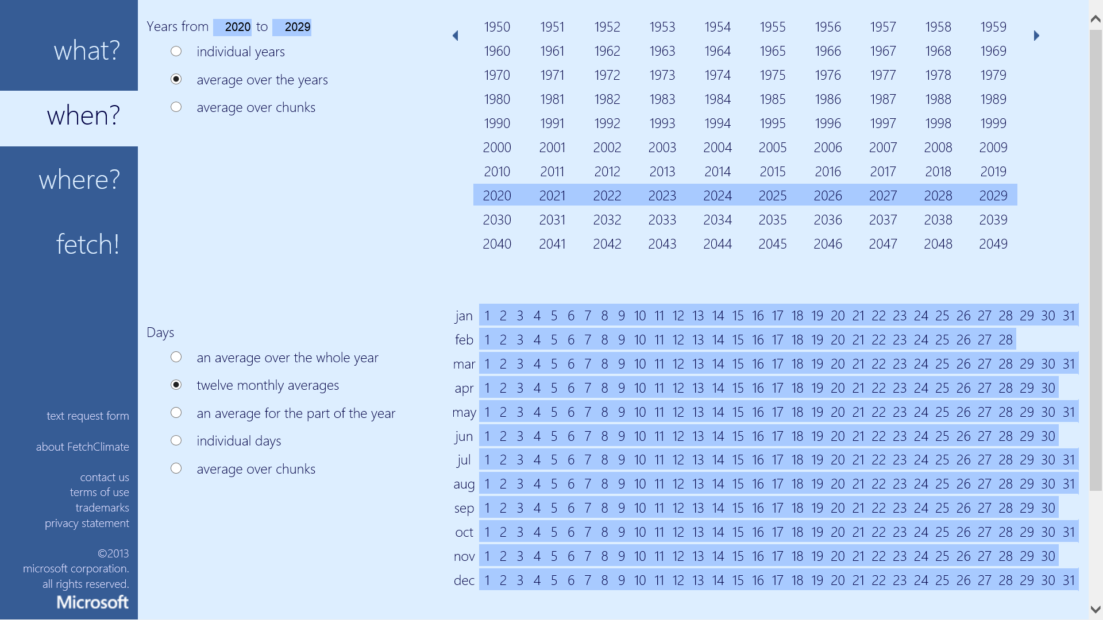
Notes:
2. Select which time interval and averaging you would like to fetch.
It automatically selects the appropriate dataset, based on the query (e.g. historical versus climate prediction for future data)
This screen is a bit detailed/complex as it allows users to specify exact time slices and average. Incredibly flexible.
Annual
Monthly
Daily
UI is being refined

Slide 9
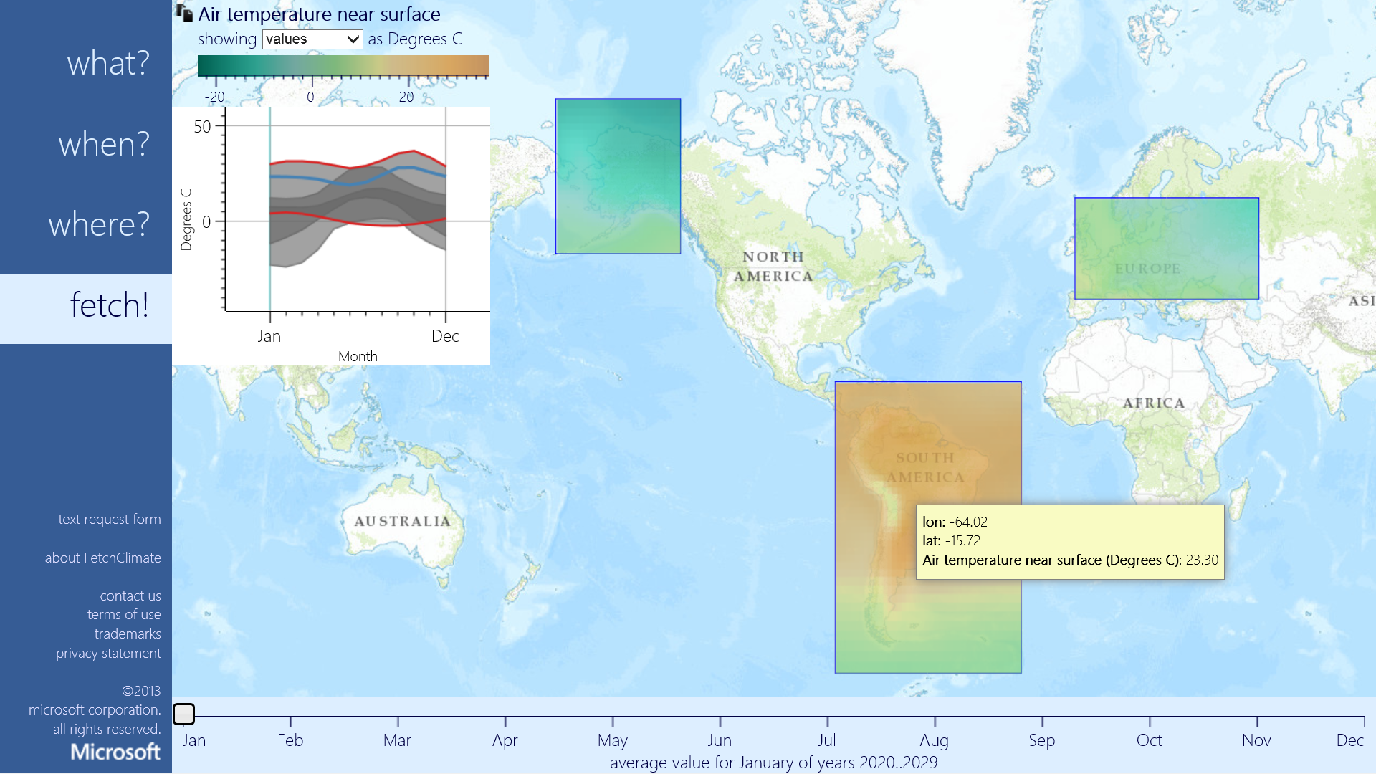
Notes:
Here results displayed

Slide 10
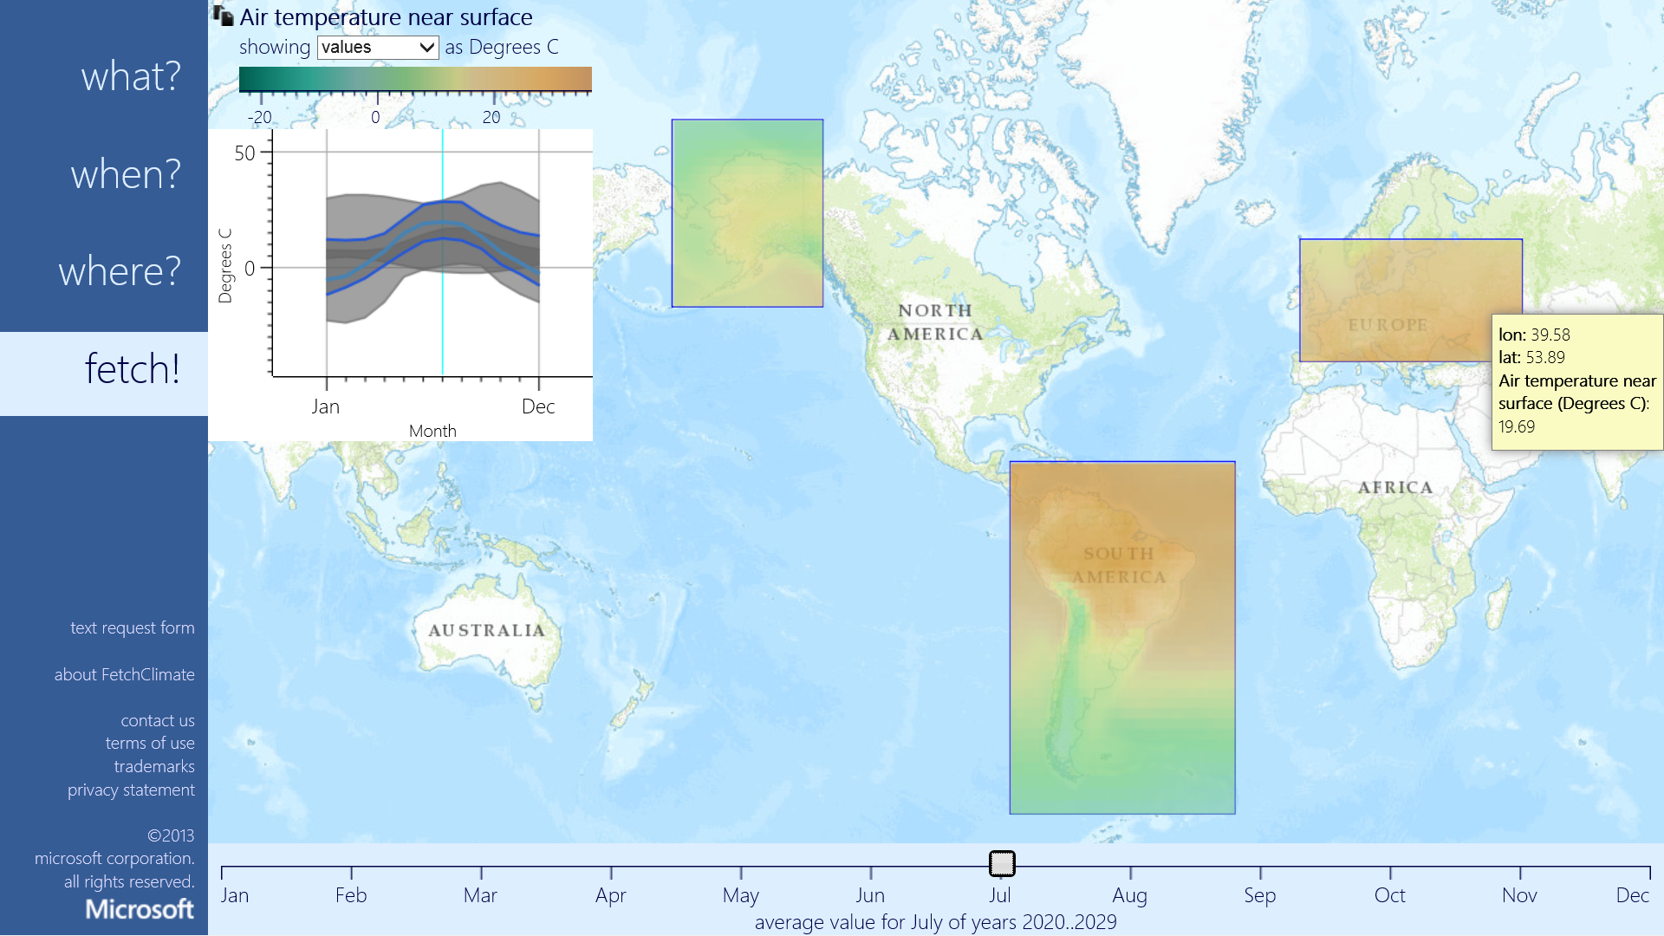

Slide 11
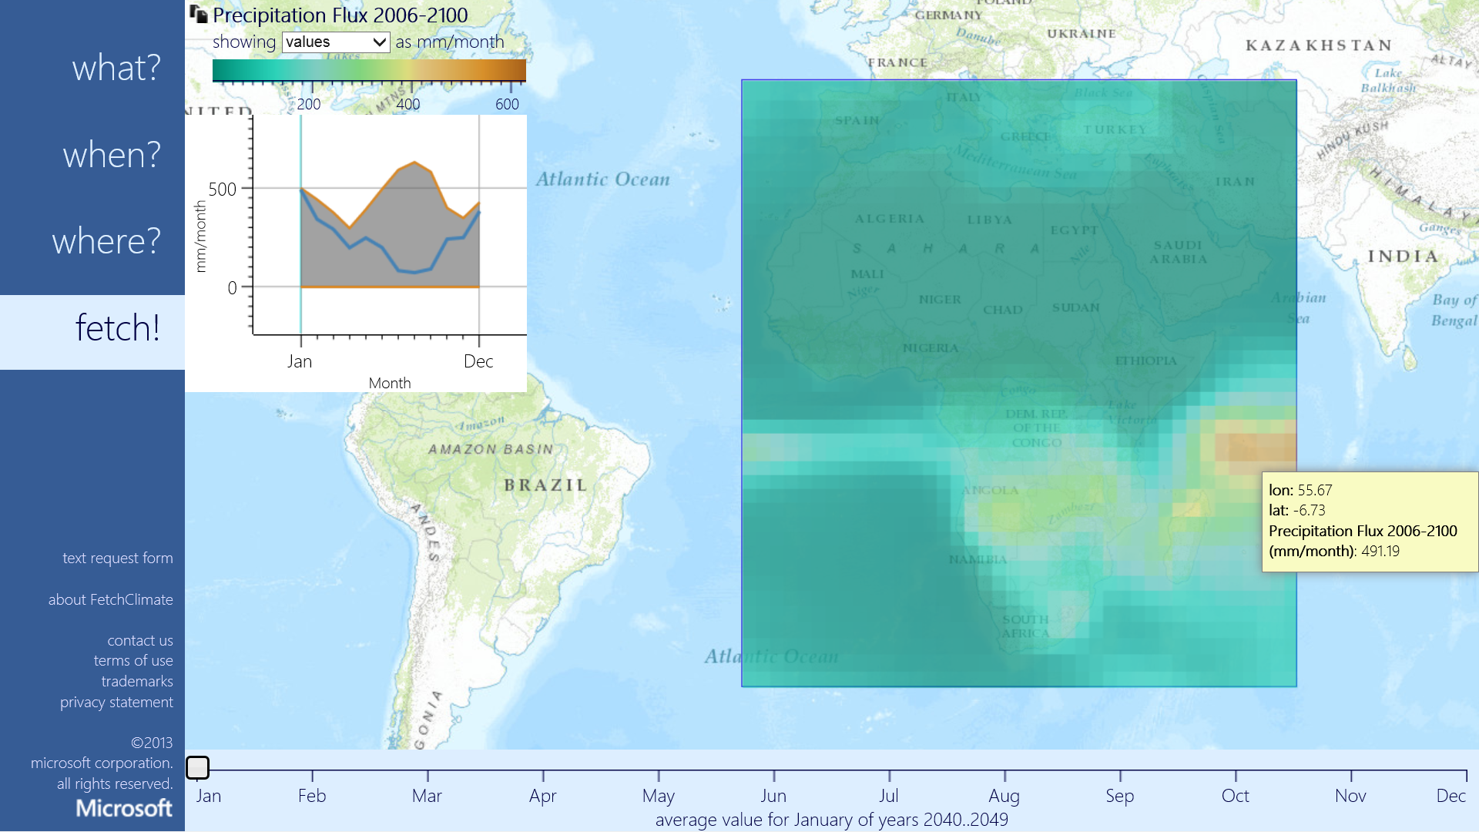
FetchClimate^{Beta}– Call to Action
Future climate simulation data
Ability to easily add new datasets
Ability to deploy your own copy of FetchClimate
Contact us!
http://fetchclimate2.cloudapp.net/
Note: This is Beta – some fetches may take several minutes, depending on complexity of underlying computation. Performance is being optimised.

